Slide 1
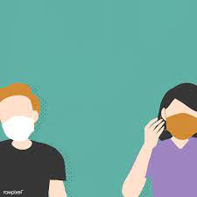
SOCIAL DISTANCING DETECTOR AND INDICATOR USING ARDUINO

Slide 2
INTRODUCTION
Coronaviruses are a type of RNA virus that infects all living things and causes sickness.
They induce respiratory tract infections in humans, which can lead to breathing difficulties. Some cases of the common cold (which can also be caused by other types of influenza viruses) cause mild symptoms in humans, whereas other Cov strains can cause SARS, MERS, and other disorders.

Slide 3
LITERATURE SURVEY
Created to determine the safe distance between individuals in public places.
In this study, the deep CNN approach and computer vision techniques are used. Initially, the pedestrian in the video frame was detected using an open-source object detection network based on the YOLOv3 method.
Only the pedestrian class was used as a result of the detection, and other object types were ignored in this application. As a result, the bounding box that best fits each identified pedestrian can be drawn in the image, and this data will be utilized to calculate distance

Slide 4
METHODOLOGY
The system's development was divided into three major phases:
1. Hardware design
2.Software design
3.Working.
The circuit was first designed and simulated during the hardware development phase. The circuit was built after it was confirmed that it produced the required output correctly.
The software development phase occurred concurrently with the hardware development phase, and a modular approach was used in which the program was divided into several modules, each of which was tested separately before being combined to form a working program.

Slide 5
BLOCK DIAGRAM

Slide 6
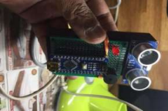
ARDUINO UNO
The Arduino UNO is a microcontroller board based chip on the ATmega328P(spreadsheet). It has sets of digital input/output pins (of which can be used as ultrasonic sensor inputs), 6 analog inputs,14 digital inputs 4 which are programmable with Arduino IDE using USB cable .
Arduino uno can be powered using an external power supply which ranges from 7- 20 volts.

Slide 7
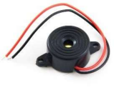
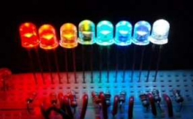
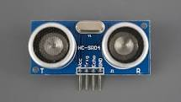
ULTRASONIC SENSOR
This ultrasonic sensor is used to measure the distance up to the range of 30-500kHzfrequencies.
There are also some low frequency ultrasonic sensors but here we were using high range of ultrasonic sensor. It usually measures the distance of an obstacle by its waves getting emitted and hit on the obstacle or a person and converts the reflected wave into an signal which is electric.
BUZZER AND LED
The buzzer is a device which gives signal by producing sound when an the electric signal is induced to it. The LED emits light and warns the person

Slide 8
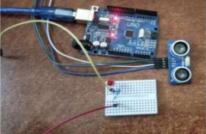
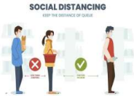
PROCESS
Waves from ultrasonic senor is converted into electric signal and the data is passed to Arduino.
Though the invisible waves will come back after hitting an optical. The Pin D1 and D2 get activated. Then the Arduino sends the data to the LED and buzzer. Where it is connected to the Pin of Arduino Uno. We've coded and sets the distance and parameters as per government norms.
The code can be modified by increasing the parameter. Echo pin which is in Arduino UNO is connected to Arduino uno is connected to Arduino digital pin number 10. The digital pin9 is connected to the trig. When it comes to LED and Buzzer negative, the two are linked. The positive wire of the buzzer will be attached to D12 pin while the positive wire connected to a D11pin.

Slide 9
ALGORITHM
STEP 1: The power supply get the Arduino and sensor to get activate
STEP 2: The activated sensor emits the invisible light which hit the person behind or before the person who is wearing this system.
STEP 3: The emitted wavelength is then return back to the sensor.
STEP 4: Then the sensor output is checked by the estimated distance as per input.
STEP 5: If the distance is less than x meter then the LED will start to glow and the buzzer will be turned ON.
STEP 6: If the distance is not less than x meter then the LED will not glow and the buzzer will remain OFF.

Slide 10
RESULTS
As a whole the system proposed is used to measure the distance between the two persons and warn the other person who is wearing it and the social distancing norms also done accordingly.
Maintaining social distance is the most effective strategy to keep COVID-19 from spreading. As a result, the created SD-Tag is an effective social distance monitoring system that can be used both indoors and outdoors to reduce the spread of infectious diseases.
COVID-19 is a virus that can be found in public places.
Other than existing solution, the proposed system is wearable and make the person to make sure that he/she is in safe distance without getting in contact with other people which may reduce the rate of transmission of viruses not only COVID-19 but also other

Slide 11

A PROJECT BY BHARATH KRISHNAN S
JANARTHANAN B

